Slide 1
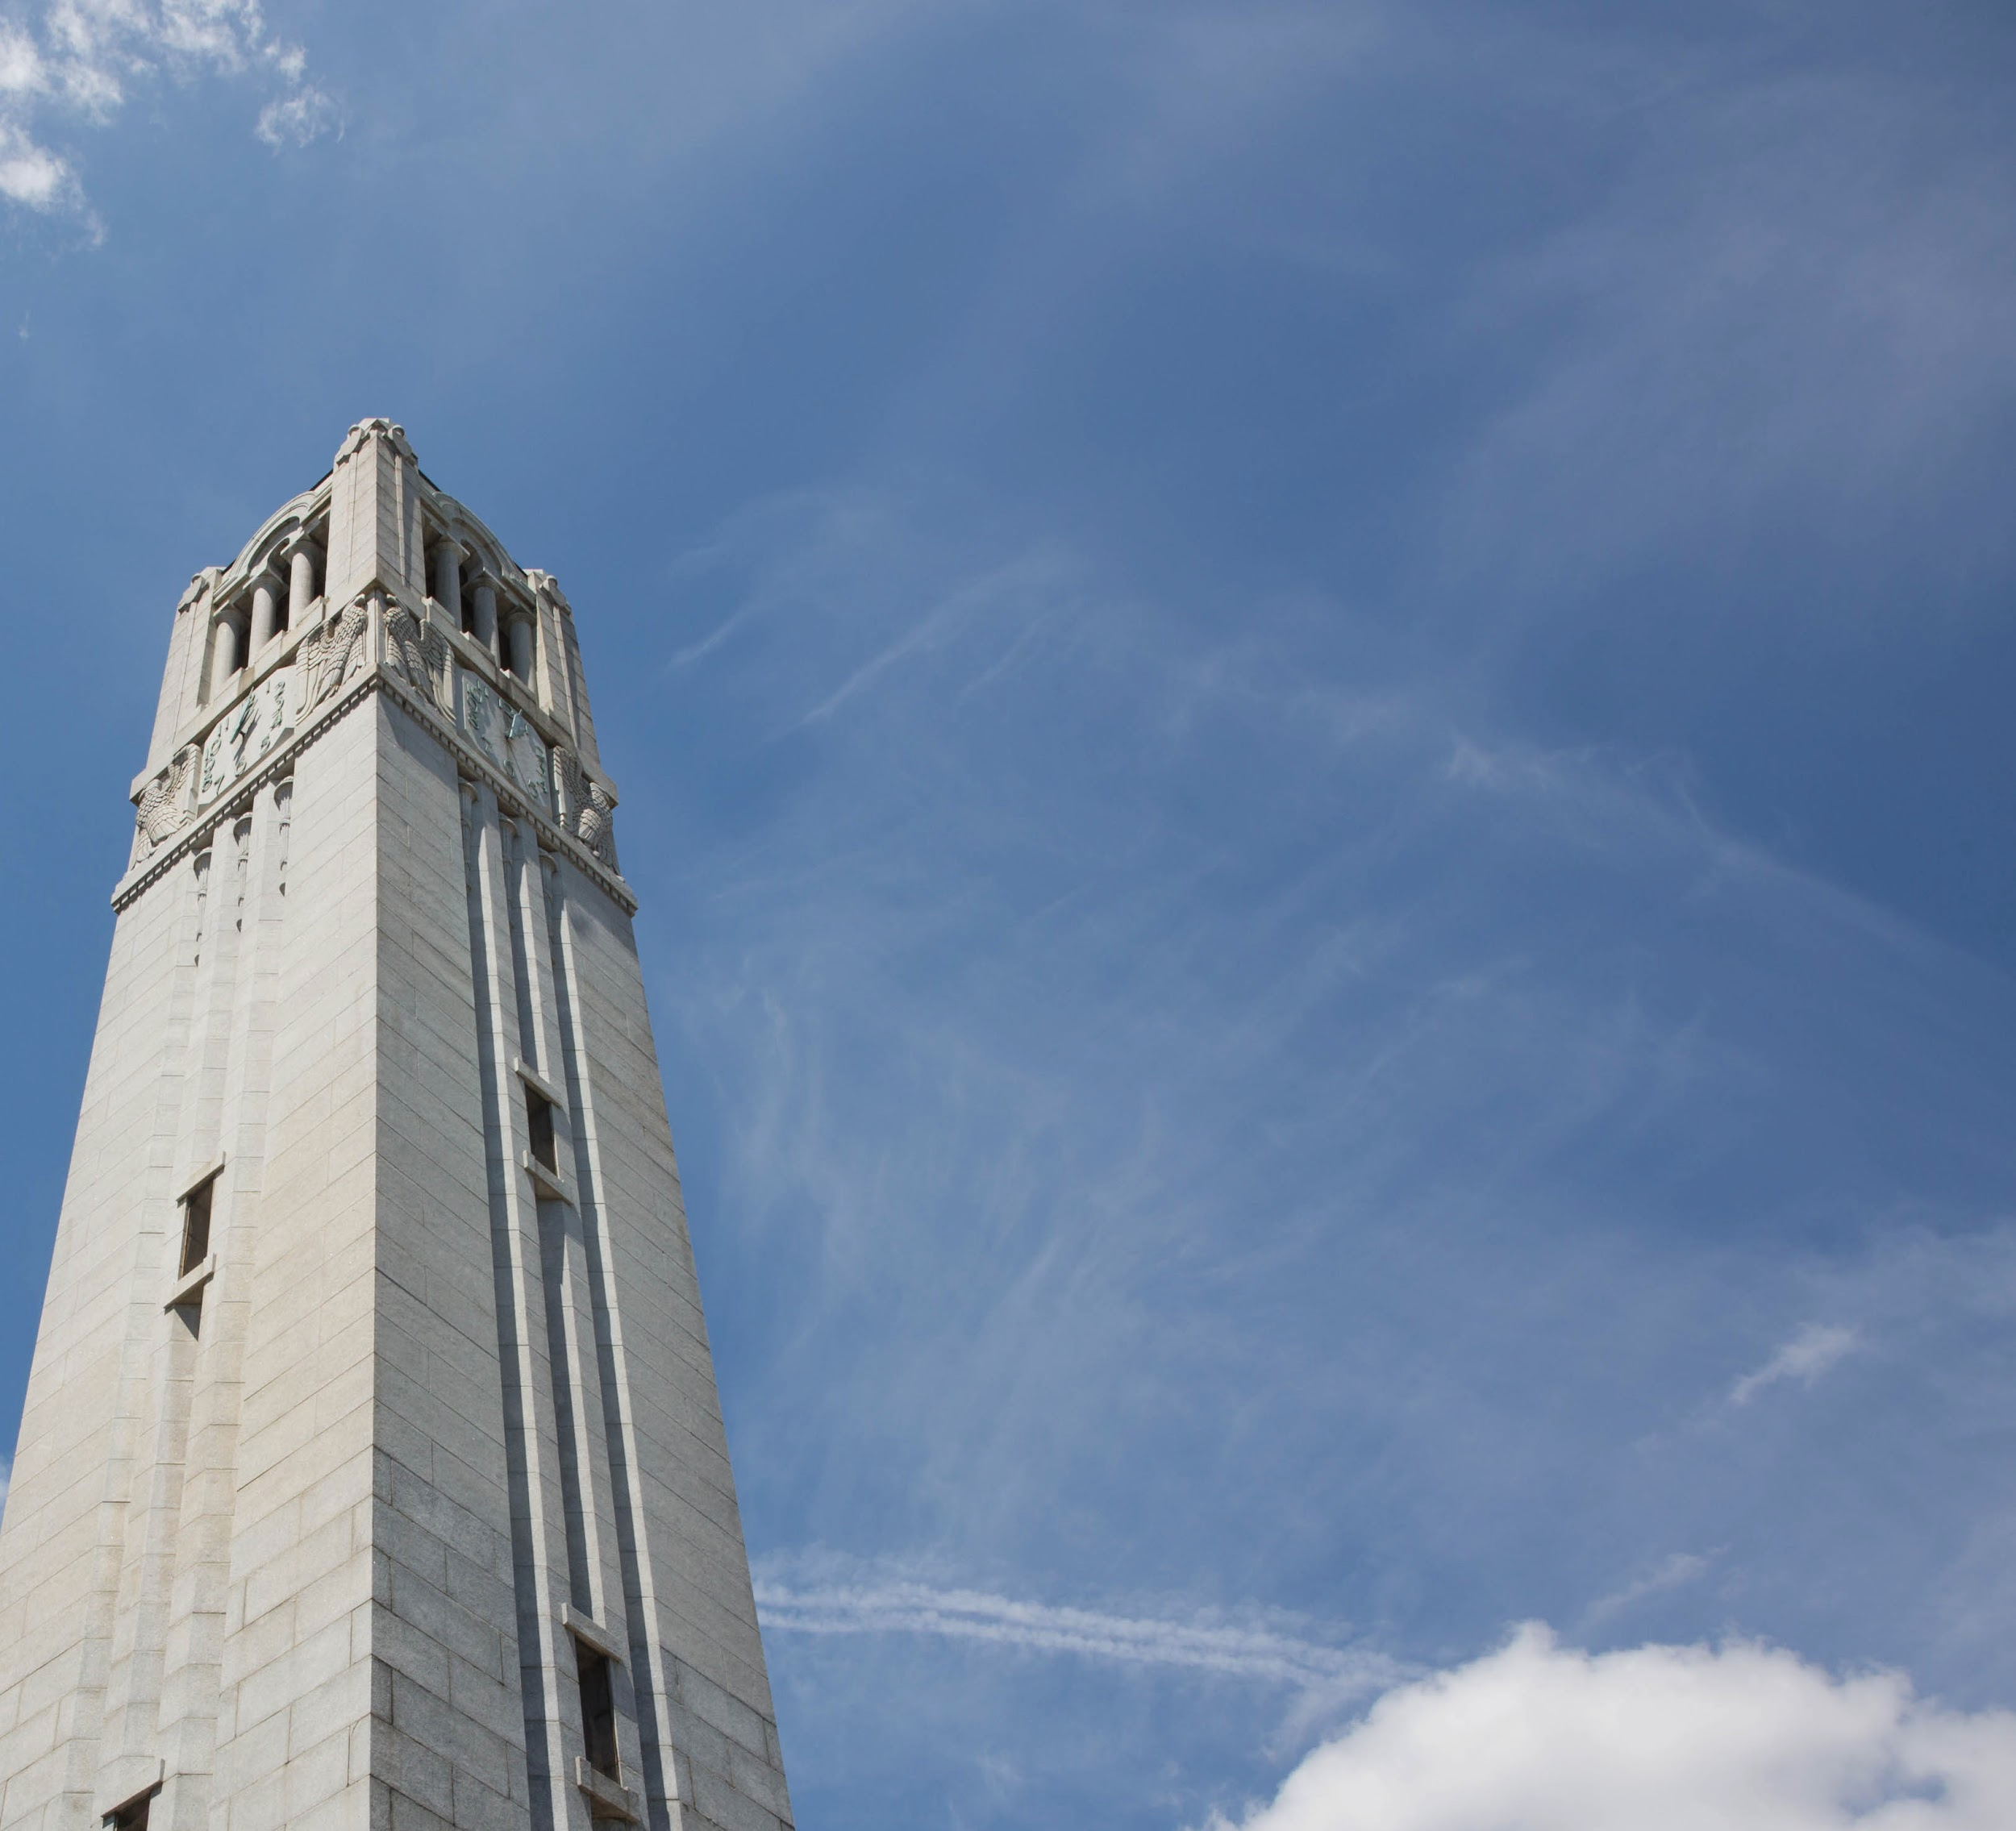

MONEY MATTERS
Student Services Center
studentservices.ncsu.edu
NC STATE UNIVERSITY | MONEY MATTERS | JULY 2024

Slide 2

Fall BILLS
Due July 24
Tuition and Fees
Housing
Meal Plan
Health Insurance
go.ncsu.edu/tuitionandfees
housing.ncsu.edu
dining.ncsu.edu
go.ncsu.edu/student-blue
unless granted exception to live at home/off campus
opt out if you wish to keep your own plan
NC STATE UNIVERSITY | MONEY MATTERS | JULY 2024

Slide 3
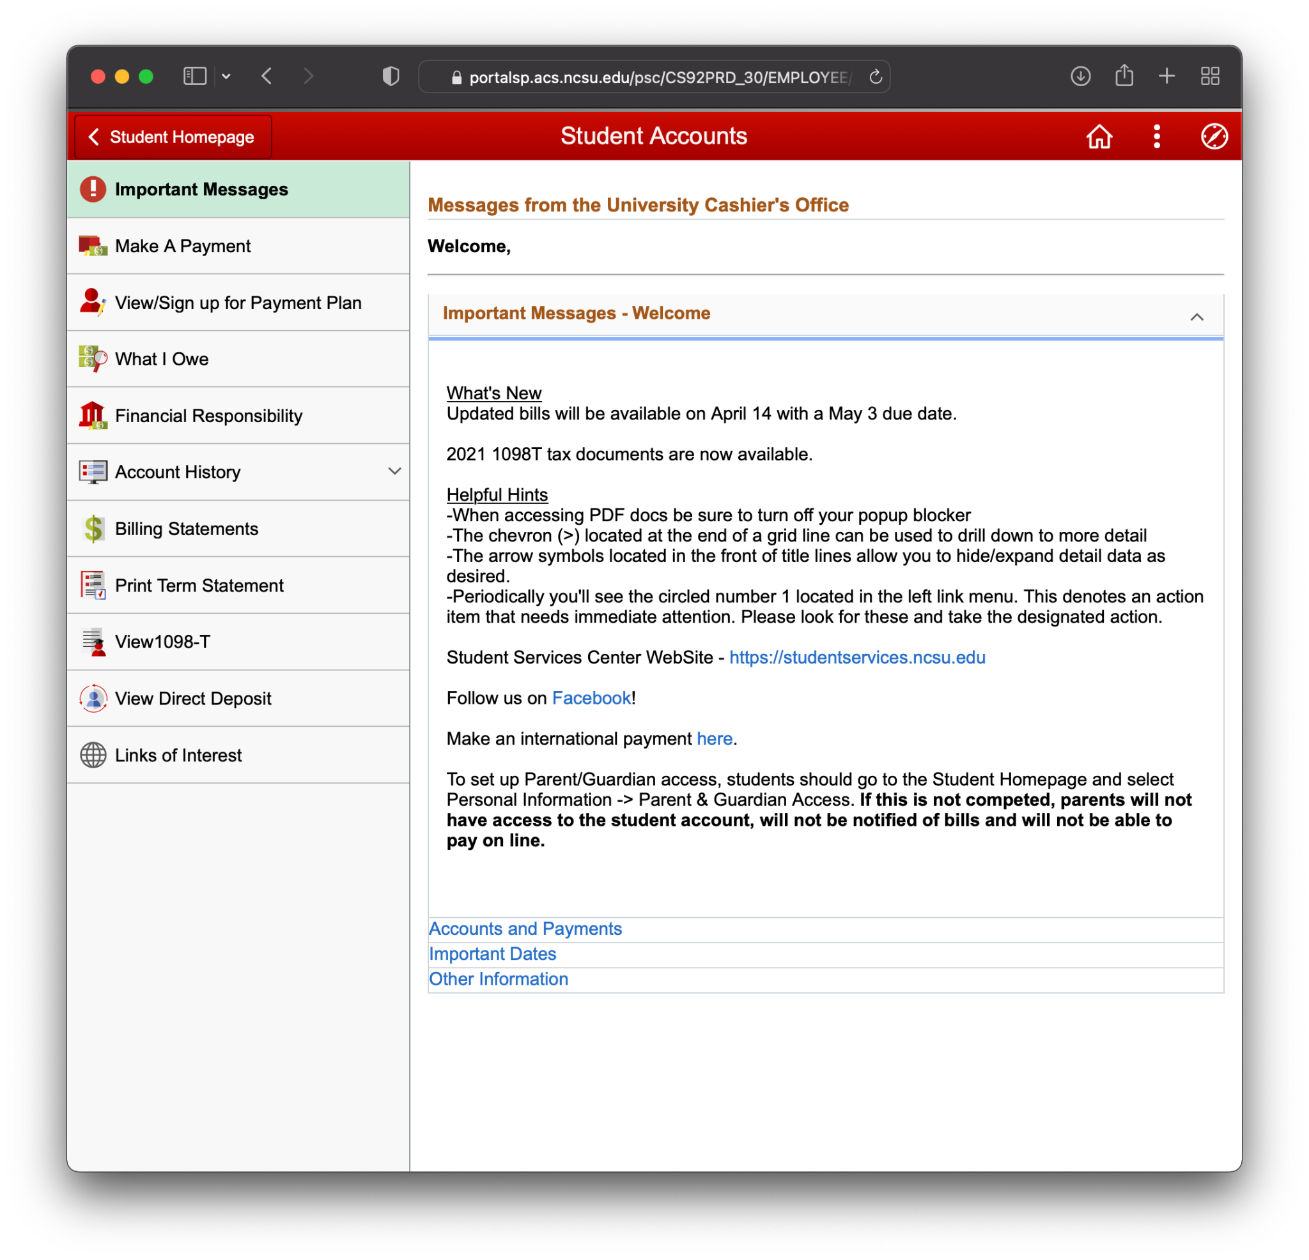
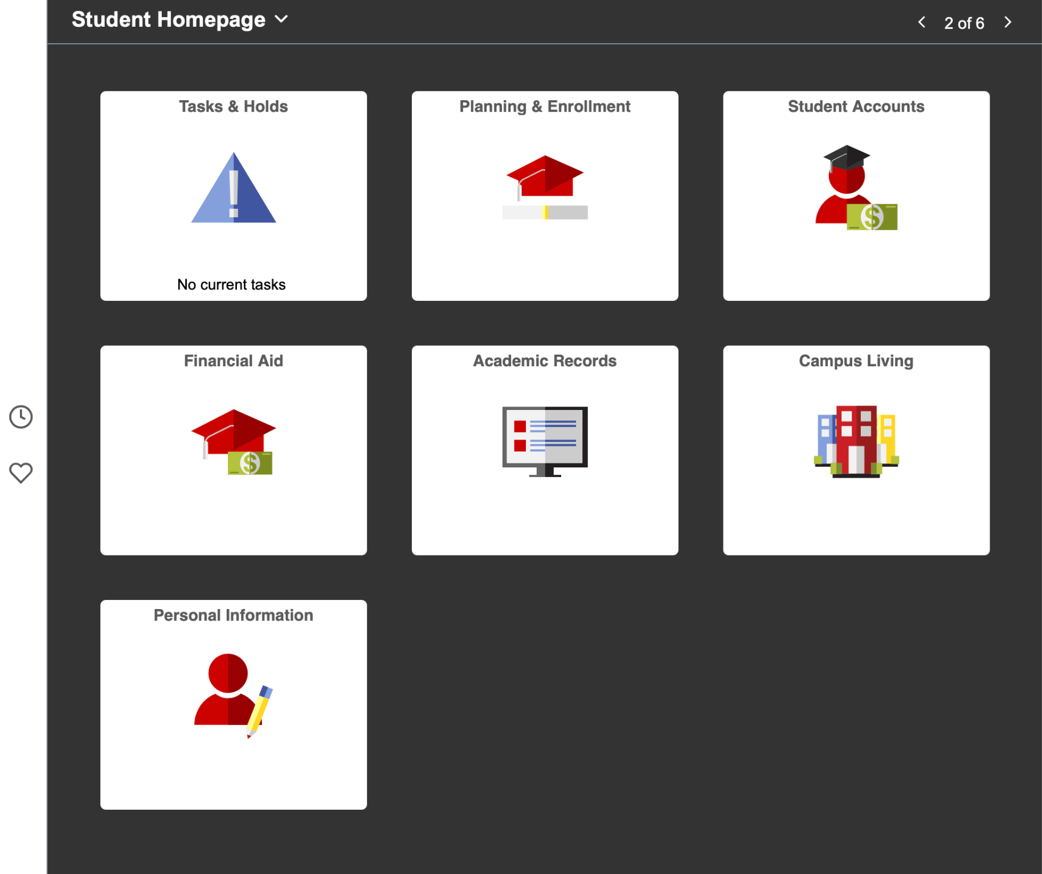
HOW DO I VIEW MY BILL?
MyPack Portal ➔ Student Accounts ➔ What I Owe/Billing Statements
MyPack Portal MyPack.ncsu.edu
Most current information
Charges and amount due as of the date it was generated.
Total charges
minus
monthly payment plan minus
accepted financial aid
=
Amount due
Pay the amount due
by the billing due date!
NC STATE UNIVERSITY | MONEY MATTERS | JULY 2024

Slide 4
HOW DO I MAKE A PAYMENT?
MyPack Portal ➔ Student Accounts ➔ Make A Payment
MyPack Portal MyPack.ncsu.edu
Charges and amount due as of the date it was generated.
E-check
preferred
Tips
Payments made via e-pay may not be automatically drafted.
Review both your personal bank account and your student account to ensure your financial records are reconciled.
Payments made via credit card incur a 2.85% transaction fee.
NC STATE UNIVERSITY | MONEY MATTERS | JULY 2024

Slide 5
WHAT ARE MY OPTIONS FOR RESOLVING
MY BALANCE DUE?
#1 Enroll in Monthly Payment Plan
MyPack.ncsu.edu ($50 Enrollment Fee)
MyPack Portal → Student Accounts tile → Enroll in Monthly Payment Plan
#2 Apply for a Federal Parent PLUS Loan
StudentAid.gov
9.08% Fixed - Students and Parents should confirm rates at StudentAid.gov
#3 Apply for a Private Education Loan
go.ncsu.edu/loans
Varied %, cosigners typically required for students
NC STATE UNIVERSITY | MONEY MATTERS | JULY 2024
Notes:
CASHIERS OFFICE NOTE- The Monthly payment plans require catch up payments, meaning it’s not too late to enroll now. Students will just have to pay June and July at once when enrolling

Slide 6
PARENT
PLUS
LOAN
How much to request on your application?
• Maximum or just enough to cover your bill?
• Consider direct vs. indirect costs
• Consider Federal loan origination fees (4.228%)
How to request refund on your application?
• Refunds to the student can be generated via direct deposit
• Refunds to the parent are mailed
Tip
Multiply the disbursed amount you need times 1.04228 to determine the amount you want to request to borrow.
NC STATE UNIVERSITY | MONEY MATTERS | JULY 2024

Slide 7
I HAVE AN OUTSIDE SCHOLARSHIP. WHAT DO I DO?
#1 Report External Scholarships on MyPack Portal
MyPack.ncsu.edu
MyPack Portal → Financial Aid → Report External Scholarship
#2 Check Your Updated Aid Offer/Pending Aid
MyPack.ncsu.edu
MyPack Portal → Students Accounts → What I Owe
#3 Mail or Drop Off Your Scholarships Checks
Office of Scholarships and Financial Aid
2016 Harris Hall, Campus Box 7302, Raleigh, NC 27695
NC STATE UNIVERSITY | MONEY MATTERS | JULY 2024
Notes:
NOTE- Make sure that scholarship checks list the STUDENT'S NAME AND/OR STUDENT ID in the memo line of the check

Slide 8
I JUST
OPTED OUT
OF HEALTH INSURANCE.
DOES THAT CHANGE MY BALANCE DUE?
UNC System Student Health Insurance: Student BlueSM
go.ncsu.edu/student-blue
Tip
The last date to opt out of health insurance and receive a credit is September 10, 2024.
If your health insurance waiver has not been processed and applied by the billing date, you will need to resolve that balance and wait for a credit once it has been processed.
NC STATE UNIVERSITY | MONEY MATTERS | JULY 2024

Slide 9
PREPAID
AND
529 PLANS
Request Funds
Request funds early
Every Vendor is Different
Contact SponsorBilling@ncsu.edu
Some send the money to you or to the school - Some require a bill from the school
Payments Processing
Processed by the University Cashier’s Office
2005 Harris Hall, Campus Box 7213, Raleigh, NC 27695
NC STATE UNIVERSITY | MONEY MATTERS | JULY 2024

Slide 10
VETERANS
BENEFITS
#1 Review Military-Connected Student Checklist
and Update Your Military Status
Go to MyPack.ncsu.edu to update your status
MyPack Portal → Personal Info
#2 Visit the Military and Veteran Services Office
veterans.ncsu.edu nctstatevets@ncsu.edu
(919) 515-6278 - 100 Witherspoon Student Center
#3 Sign Up for the GI Bill Payment plan (VA Students)
gibillfinance@ncsu.edu
MyPack Portal Student Accounts
NC STATE UNIVERSITY | MONEY MATTERS | JULY 2024
Notes:
CASHIERS OFFICE NOTE- Stress that they need to contact the Veterans Education Office for help

Slide 11
WHY DOES MY FINANCIAL AID
SHOW AS PENDING AID ON THE
BILLING STATEMENT?
MyPack Portal ➔ Student Accounts ➔ What I Owe
MyPack Portal MyPack.ncsu.edu
MyPack Portal MyPack.ncsu.edu
Most current information
Tip
Financial aid will show as pending until the funds disburse to the Student Account. This typically happens around the first day of classes for the Fall and Spring terms.
NC STATE UNIVERSITY | MONEY MATTERS | JULY 2024

Slide 12
HOW DO I SIGN UP
FOR DIRECT DEPOSIT?
MyPack Portal ➔ Student Accounts ➔ Direct Deposit
MyPack Portal MyPack.ncsu.edu
Tip
If there is a credit on your account and you are due a refund, the Cashier’s Office will refund that into the Direct Deposit account you have designated.
Always reconcile your account before utilizing any refunds.
NC STATE UNIVERSITY | MONEY MATTERS | JULY 2024

Slide 13
HOW DO I
ACCESS THE PIN NEEDED FOR STUDENT AND PARENT/
OTHER DESIGNEE?
MyPack Portal ➔ Personal Information
MyPack Portal MyPack.ncsu.edu
Tips
Student must create
a Student PIN
Student must grant access to Parent(s)/Other for us to share information
NC STATE UNIVERSITY | MONEY MATTERS | JULY 2024
Notes:
CASHIERS OFFICE NOTE- Explain there are two steps. Student grants access and creates PIN. But then parent gets email to complete the set up which will then allow them to receive the same email notifications we send the student. E-bill and cancellation emails.
Also important to clarify that we send an email letting them know charges are posted. We don’t email the actual bill.

Slide 14
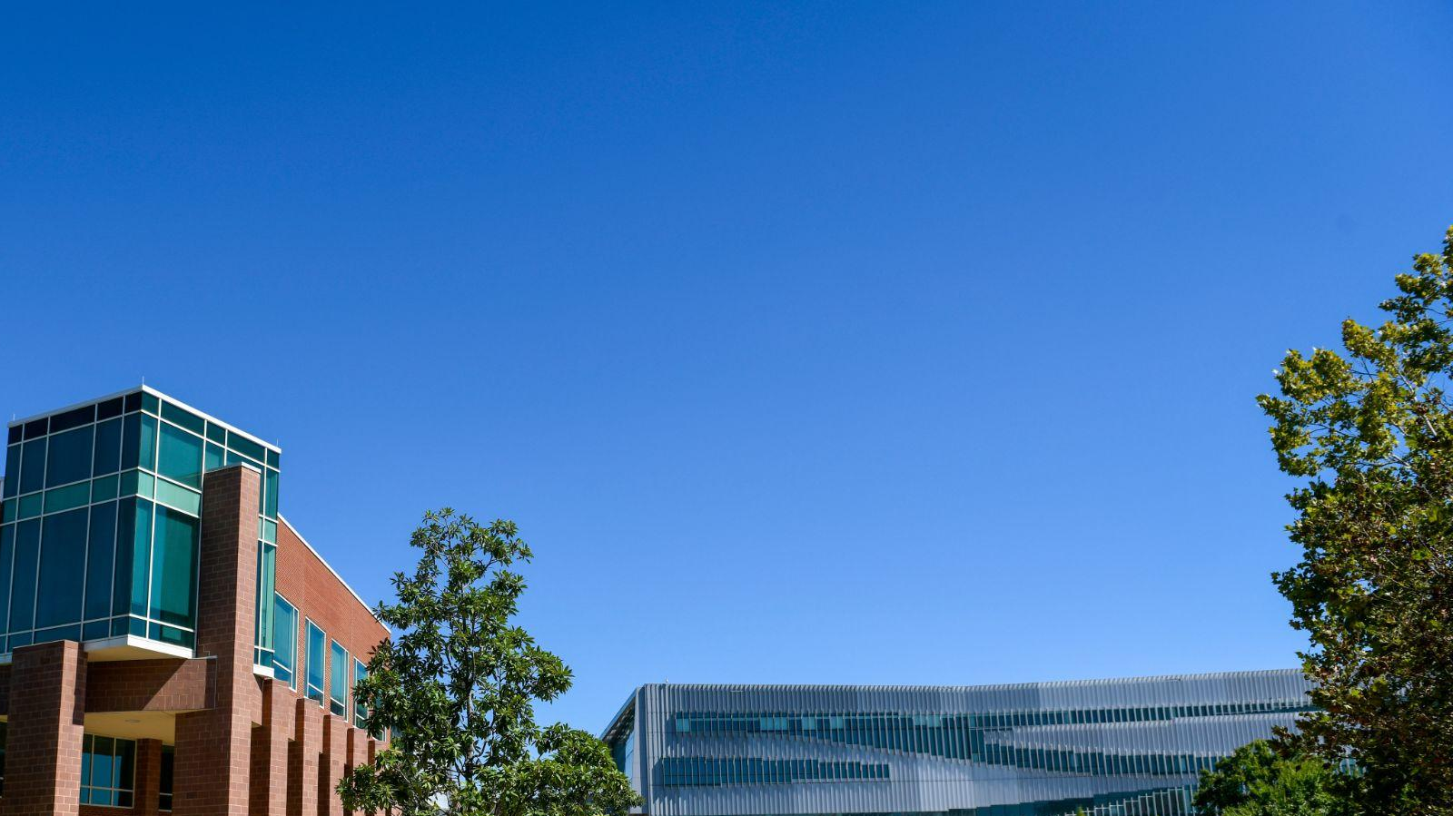
REVIEW YOUR
STUDENT ACCOUNT REGULARLY
Tuition and Fees
New Loan Approval
Parking Fines
Student Health Visits
Tuition/Fee Adjustments Due to Enrollment Changes
Payment Plan Updates
529/Prepaid Payments
Library Fines
Meal Plan Changes
Financial Aid Adjustments for Enrollment Changes
Scholarships Updates
Bookstore Charges
Student Health Insurance Changes
Housing Changes
NC STATE UNIVERSITY | MONEY MATTERS | JULY 2024

Slide 15

GET HELP
Call, email or stop by! No appointment necessary.
(919) 515-6278 - studentservices@ncsu.edu - 2nd Floor of Harris Hall (Mon. - Fri. 8 a.m. - 5 p.m.)
Student Services Center
studentservices.ncsu.edu
NC STATE UNIVERSITY | MONEY MATTERS | JULY 2024

